Slide 1
Project Proposal: Heterogeneous Architecture Design for Mesh
ECE 8823 Interconnection Networks
Presented by Wan-Chen Yeh
Mar. 16, 2016

Slide 2
Motivation
Mesh is mostly studied in NoC
scalability, regularity, and ease of implementation
Homogeneous network design – easier for designer (+)
The resource utilization is non-uniform (-)
Problem I am going to solve
Obtain the utilization information by simulating the buffer average occupancy
Implement new heterogeneous traffic/topology to compare to the baseline

Slide 3
Approaches – 1/2
How I will implement the design
The simulations will be executed on gem5
Baseline: an 8x8 Mesh with XY routing, each router has 8 VCs
Store the buffer occupancy of every cycle and get the average
Implement heterogeneous traffic pattern/topology
What components will change from the baseline
Basic traffic:
Uniform Random
Bit-complement
Tornado
New heterogeneous traffic/topology

Slide 4
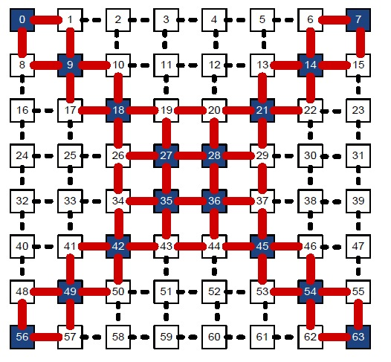
Approaches – 2/2
1x
3x
New components
Traffic patterns
Hotspot
Multiple injection rates for Mesh
Topology:
Mesh with link redistribution – twice link width for diagonal routers
Evaluations
Average buffer occupancy for every router
Different levels of injection rate (low, medium, high)
Various traffic patterns
4x
2x

Slide 5
Plan of the project
Timeline

Slide 6
Thank you!

